Slide 1
Topic 2: binary Trees and Tree Traversals
COMP2014J: Data Structures and Algorithms 2
Dr. David Lillis (david.lillis@ucd.ie)
UCD School of Computer Science
Beijing-Dublin International College

Slide 2
Labs
Labs start next week.
Bring your own laptop.
Should have:
Recent version of Eclipse.
Java Development Kit (Java 8 or later).

Slide 3
Binary Tree
A Binary Tree is a special type of tree.
This means that it has all of the normal properties of a tree that we discussed in the last lecture.
However, it also has some additional properties:
Every node has at most 2 children (degree 2).
Each child node is labelled as being either a left child or a right child.
A left child comes before a right child in the ordering of children of a node.
i.e. whenever we have to process the children of a node, we do the left one first, then the right.
Proper Binary Tree: a Binary Tree in which all nodes have degree 0 or 2.

Slide 4
Binary Tree
A Binary Tree, T, is either empty or combines:
a node r, called the root of T, which stores an element
a binary tree, called the left subtree of T
a binary tree, called the right subtree of T
Level Property: Level d of a binary tree is the set of all nodes with depth d, of which there are at most 2^{d} nodes.

Slide 5
Example: Arithmetic Operations
(1 + 3) x (7 – (2 + 1))
↓
Level 0: Max 2⁰ nodes = 1
x
Level 1: Max 2¹ nodes = 2
+
-
Level 2: Max 2² nodes = 4
1
3
7
+
Level 3: Max 2³ nodes = 8
2
1

Slide 6
Binary Tree ADT
Binary Tree ADT = Tree ADT + 4 extra operations:
left(n) return the Node of n’s left child
right(n) return the Node of n’s right child
hasLeft(n) test whether n has a left child
hasRight(n) test whether n has a right child
The corresponding Java Interface mirrors this:
public interface IBinaryTree<T> extends ITree<T> {
public INode<T> left(INode<T> n);
public INode<T> right(INode<T> n);
public boolean hasLeft(INode<T> n);
public boolean hasRight(INode<T> n);
}
We still don’t provide methods to add/remove from the tree – these are left to the implementation strategy.

Slide 7
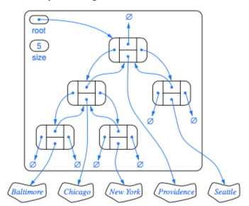
Link-Based Binary Tree: Structure
Similar to how we use link-based implementation for list/stack/queue:
Nodes contain data (the element)
Key Relationships: parent / child (not previous / next)
Entry point: The root node
Additional Issues: the number of nodes in the tree (size)
parent
element (data)
left
child
right
child

Slide 8
Link-Based Binary Tree: Operations
Update Operations:
addRoot(e) create and return a new root node storing e; an error should occur if the tree is not empty
insertLeft(n, e) create and return a new node storing e as the left child of n; an error should occur if n already has a left child.
insertRight(n, e) create and return a new node storing e as the right child of n; an error should occur if n already has a right child.
remove(n) remove node n and replace it with its child, if any, and return the element stored at n; an error occurs if n has two children.
attach(n, T1, T2) Attach T1 and T2 respectively, as the left and right subtrees of the external node n; an error occurs if n is not external.

Slide 9
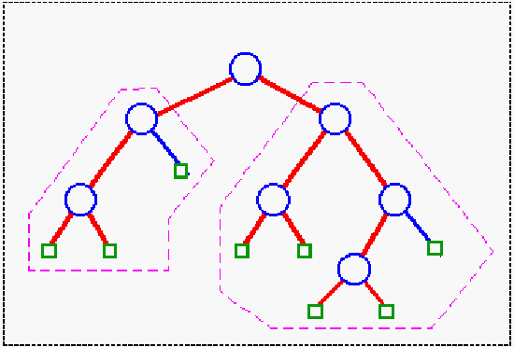
Proper Linked Binary Trees
For a Proper Binary Tree:
Every node, n, has degree 0 (external node) or 2 (internal node).
Build the tree by expanding external nodes to become internal nodes.
Default Implementation: Only internal nodes hold data.
Less flexible but can simplify the implementation of data structures.
We generally use empty squares to represent the external nodes, which do not hold data.
Internal Nodes (store data)
a
b
c
d
e
f
External Nodes (do not store data)
g
Notes:
01/03/2017 finished on this slide.

Slide 10
Proper Linked Binary Trees
Key Operations:
expandExternal(n,e) | Create two new empty nodes (i.e. that have no value) and add them as the left and right children of n, and store data e at n. An error occurs if n is not external.
remove(n) | If the left child is external, remove it and n and replace n with the right child. If the right child is external, remove it and n and replace it with the left child. Error if both children are internal or n is external.

Slide 11
Expanding an External Node
6
Let’s expand the right child of “8” to store the number 3.
2
9
1
4
8

Slide 12
Expanding an External Node
6
The node to be expanded is given two empty child nodes.
2
9
1
4
8

Slide 13
Expanding an External Node
6
The value (3) is stored in the expanded node.
Internal nodes cannot be expanded.
This is the method used to add nodes to a proper binary tree.
2
9
1
4
8
3

Slide 14
Removing a Node
Only an internal node with at least one external child can be removed.
In this example, 6 and 2 cannot be removed.
Neither can any of the external nodes (it would no longer be a proper binary tree).
6
2
9
1
4
8
3

Slide 15
Removing a Node
Let’s remove 9.
9 has an external child (right child) so it can be removed.
We will remove 9 and its right child.
9 is replaced with its left child (8).
6
2
9
1
4
8
3

Slide 16
Removing a Node
Let’s remove 9.
9 has an external child (right child) so it can be removed.
We will remove 9 and its right child.
9 is replaced with its left child (8).
6
2
8
1
4
3

Slide 17
Removing a Node
Now let’s remove 8.
8 has an external child (left child) so it can be removed.
We will remove 8 and its left child.
8 is replaced with its right child (3).
6
2
8
1
4
3

Slide 18
Removing a Node
Now let’s remove 8.
8 has an external child (left child) so it can be removed.
We will remove 8 and its left child.
8 is replaced with its right child (3).
6
2
3
1
4

Slide 19
Removing a Node
Finally, we remove 3.
3 has an external child (in fact it has 2), so it can be removed.
We remove 3 and its left child, replacing it with its right child.
6
2
3
1
4

Slide 20
Removing a Node
Finally, we remove 3.
3 has an external child (in fact it has 2), so it can be removed.
We remove 3 and its left child, replacing it with its right child.
6
2
1
4

Slide 21
Tree Traversals and the Visitor Pattern

Slide 22
Visitor Pattern
Design Pattern: a general reusable solution to a commonly occurring problem within a given context in software design.
Visitor Pattern: a way of separating an algorithm from an object structure on which it operates.
Traversal Algorithms are used to visit nodes in a tree.
Same algorithm applies to general trees and binary trees.
Visitor Pattern allows us to implement once and reuse.

Slide 23
Traversing a Tree
When visiting nodes in a tree structure, it can be important to decide what order to visit the nodes in.
The act of travelling through a tree visiting nodes is known as a traversal.
Depending on the order you want to visit the nodes in, you can choose an appropriate traversal type. There are several options.
The choice of traversal type will depend on what you are using the tree to represent.

Slide 24
“Visiting” a node.
The act of “visiting” a node generally involves some kind of processing.
It will depend on what you are trying to do.
Some examples:
Print the object stored in the node.
Make a calculation based on the node’s value.
Find a particular value in the tree.
Some more complex processing.

Slide 25
Preorder Traversal of a Binary Tree
Algorithm preorder(T,v):
perform the "visit" action for node v
if v has a left child u in T then preorder(T,u) if v has a right child w in T then
preorder(T,w)
A preorder traversal visits a node before it recursively visits its subtrees (left first, then right).
When we recursively visit a subtree, it means that we visit all the descendants in that subtree before we go further.
Preorder traversal can be used with any tree type.

Slide 26
Preorder Traversal
Next we visit the left child of 7 (which is 3). We must recursively finish the traversal of this sub-tree before we do the right child (12).
After visiting the left subtree, we can now start on the right.
1
2
9
3
6
10
14
4
5
7
11
12
15
Traversal order: 7, 3, 1, 0, 2, 6, 4, 5, 12, 9, 8, 11, 10, 13, 15, 14
8
13
16
Notes:
NOTE: This slide has animations to help to explain the ordering.

Slide 27
Inorder Traversal
Algorithm inorder(T,v):
if v has a left child u in T then inorder(T,u) perform the "visit" action for node v
if v has a right child w in T then
inorder(T,w)
An inorder traversal visits a node after recursively visiting its left subtree, but before recursively visiting the right subtree.
A node cannot be visited until all of its descendants in the left subtree have been visited (but before any in the right subtree).
Inorder traversal only makes sense for binary trees.

Slide 28
Inorder Traversal
This time, we must recursively visit the left subtree first, before visiting the root node (7).
But: when we recursively visit the left subtree, we must also visit 3’s left child before 3 itself.
The same is true at 1.
8
4
13
Traversal order:
0, 1, 2, 3, 4, 5, 6, 7, 8, 9, 10, 11, 12, 13, 14, 15
2
7
10
14
1
3
5
9
12
16
6
11
15
Notes:
NOTE: This slide has animations to help to explain the ordering.

Slide 29
Postorder Traversal of a Binary Tree
Algorithm postorder(T,v):
if v has a left child u in T then postorder(T,u) if v has a right child w in T then
postorder(T,w)
perform the "visit" action for node v
A postorder traversal visits a node after recursively visiting all its child subtrees (left first, then right).
A node will not be visited until all its descendants have been visited.
Postorder traversal can be used with any tree type.

Slide 30
Postorder Traversal
The root node will always be last in the traversal, as we must visit all its descendants first.
The left subtree is first, but again we cannot visit 3 (or 1) until after all its descendants.
Now that all of 3’s descendants have been visited, we can visit 3.
We must do the entire right subtree before visiting 7.
Traversal order: 0, 2, 1, 5, 4, 6, 3, 8, 10, 11, 9, 14, 15, 13, 12, 7
16
7
15
3
6
11
14
1
2
5
8
10
13
4
9
12
Notes:
NOTE: This slide has animations to help to explain the ordering.

Slide 31
Which traversal to choose?
The type of traversal depends on what kind of data your tree represents.
What kind of traversal would is most appropriate for the following situations, and why?
Freeing memory in a tree (deleting a tree one node at a time).
Postorder: we don’t delete parent nodes before their children. Deleting parent nodes would mean that we no longer have references to the child nodes.
Making a copy of a tree.
Preorder: Since parent nodes are visited before children, we can create the parents in the copy before adding their children.

Slide 32
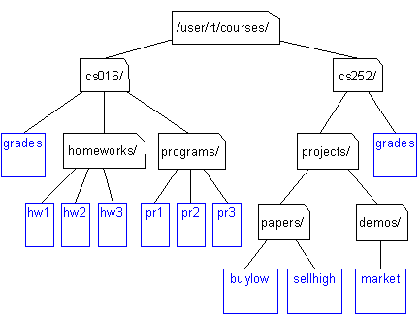
Which traversal to choose?
When using a tree to represent a filesystem, calculating the size of a directory/folder.
Directory size is defined as the sum of the size of all files in a directory or its subdirectories.
Postorder: we can calculate the size of all of the subdirectories first (child subtrees), and then sum those to get the size of each directory.

Slide 33
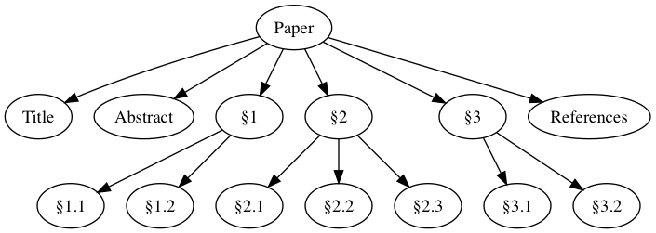
Which traversal to choose?
Paper
Title
Abstract
§1
§ 1.1
§ 1.2
§ 2
§ 2.1
§ 2.2
§ 2.3
§ 3
§ 3.1
§ 3.2
References
When a tree is used to represent the structure of a document, and you want to present the table of contents.
Preorder: Each section is visited before the sections that are inside it.

Slide 34
Why Inorder traversal?
When using a binary search tree (which we will look at in the next lecture), performing an inorder traversal means that we can visit the values stored in the tree in sorted order.

Slide 35
A Problem to Think About
Suppose there is a binary tree storing letters.
The tree does not contain duplicate values.
It is not a binary search tree.
If you were given any two of the outputs from the three traversals (preorder, postorder, inorder), can you recreate the binary tree?
If so, how? Which 2 do you need?
Example:
Preorder: F B A D C E G I H
Inorder: A B C D E F G H I
Postorder: A C E D B H I G F

